Slide 1
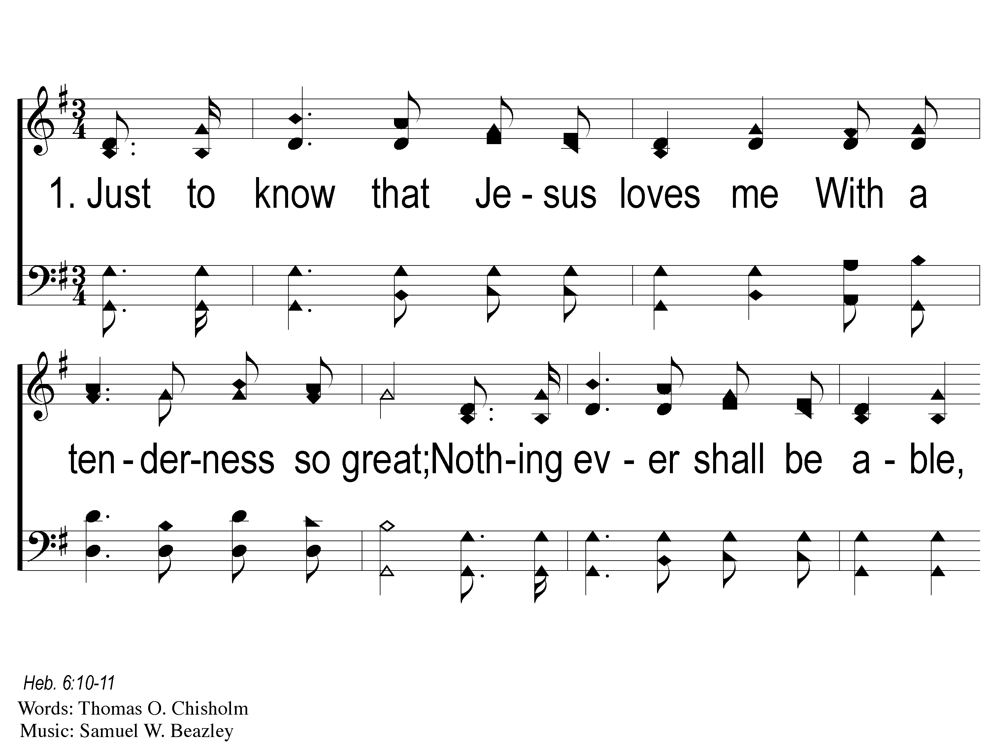
1-1 Just to Know
Just To Know
81
ePraise Hymn Presentation © 2005 Taylor Publications
ePraise Hymn Presentation © 2005 Taylor Publications

Slide 2
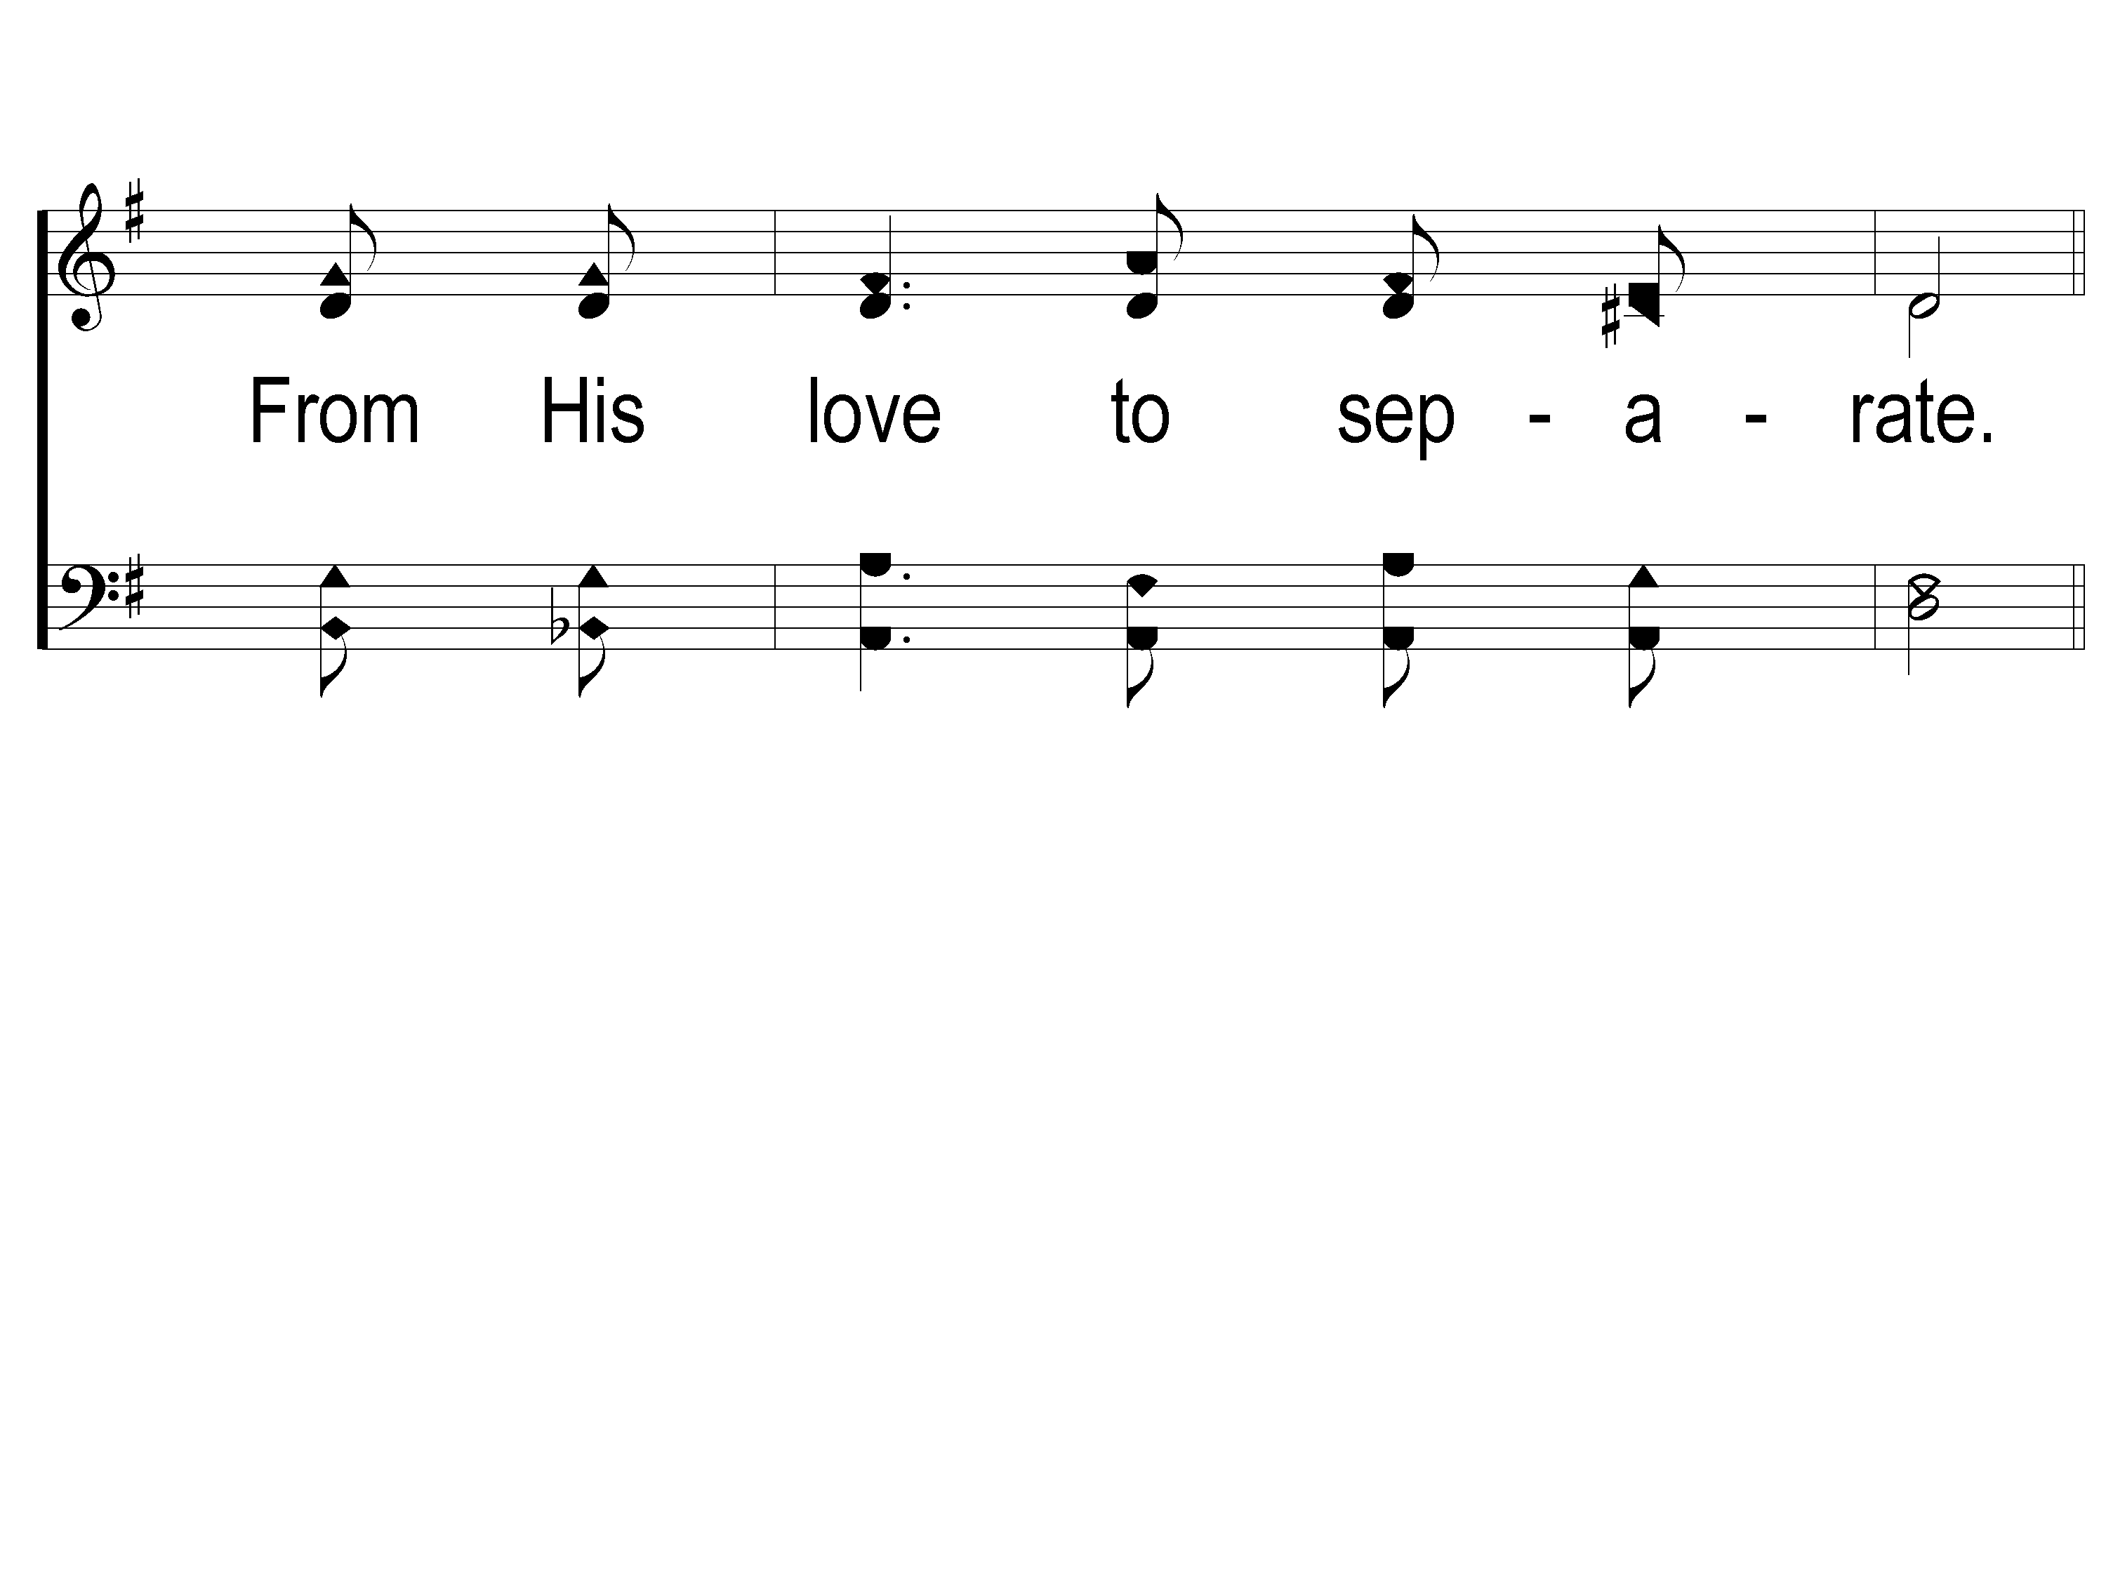
1-2 Just to Know
Just To Know
81
ePraise Hymn Presentation © 2005 Taylor Publications
ePraise Hymn Presentation © 2005 Taylor Publications

Slide 3
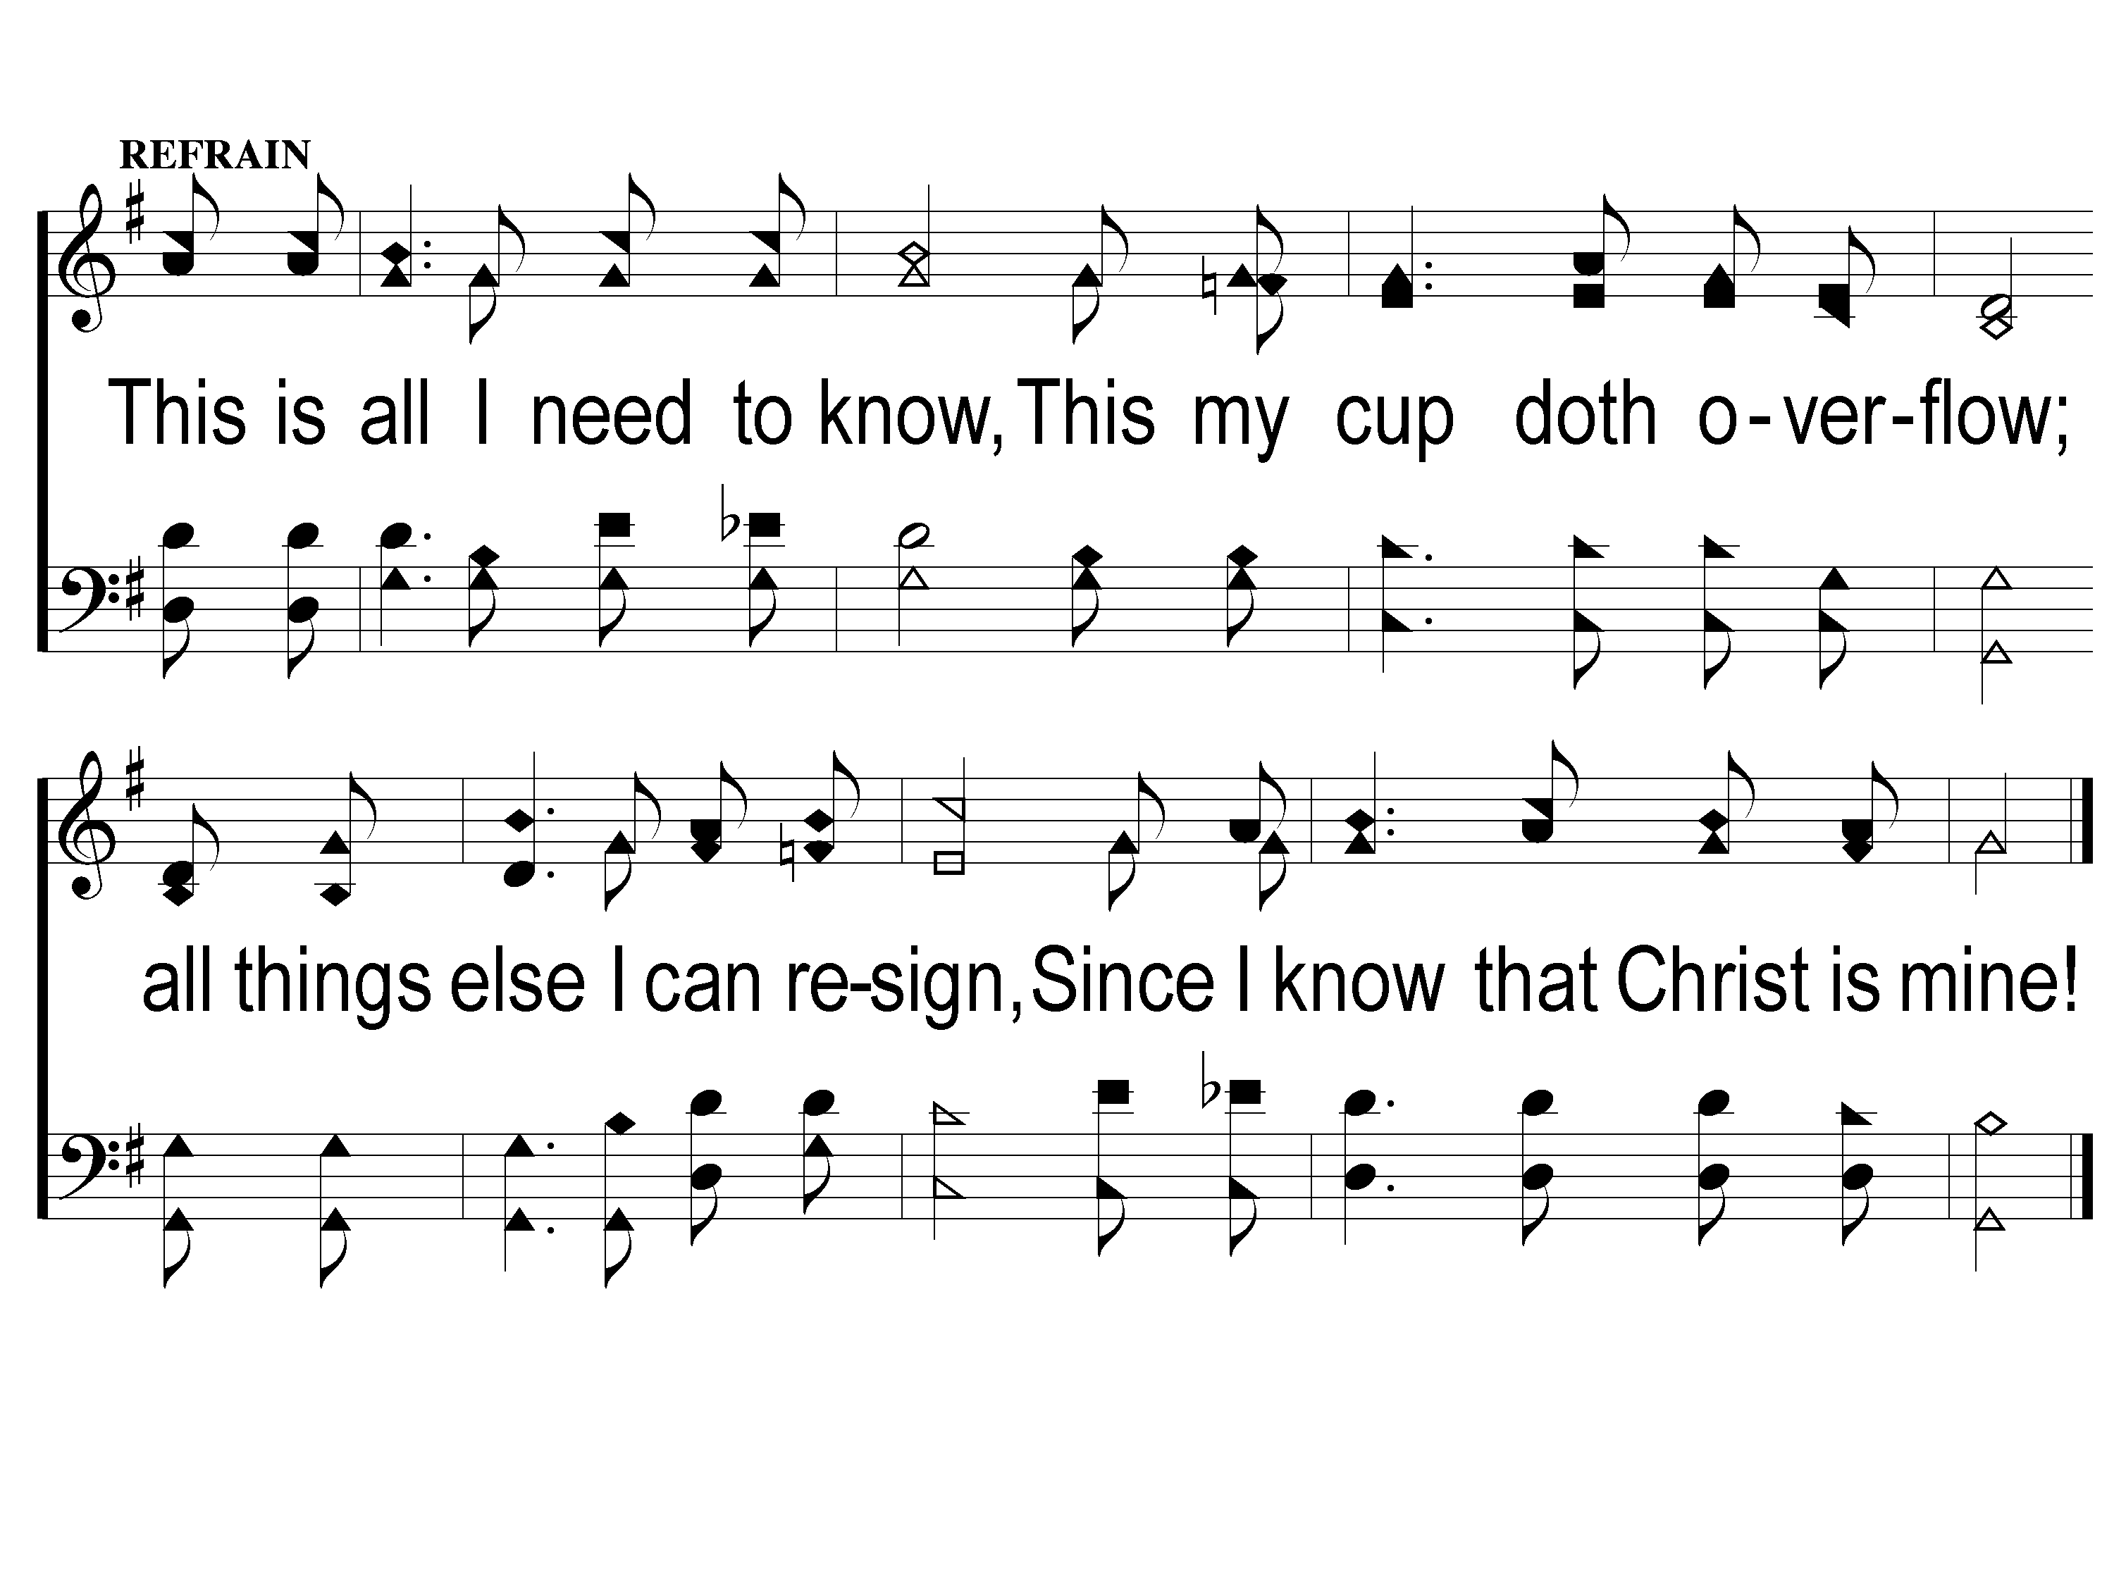
c Just to Know
Just To Know
81
ePraise Hymn Presentation © 2005 Taylor Publications
ePraise Hymn Presentation © 2005 Taylor Publications

Slide 4
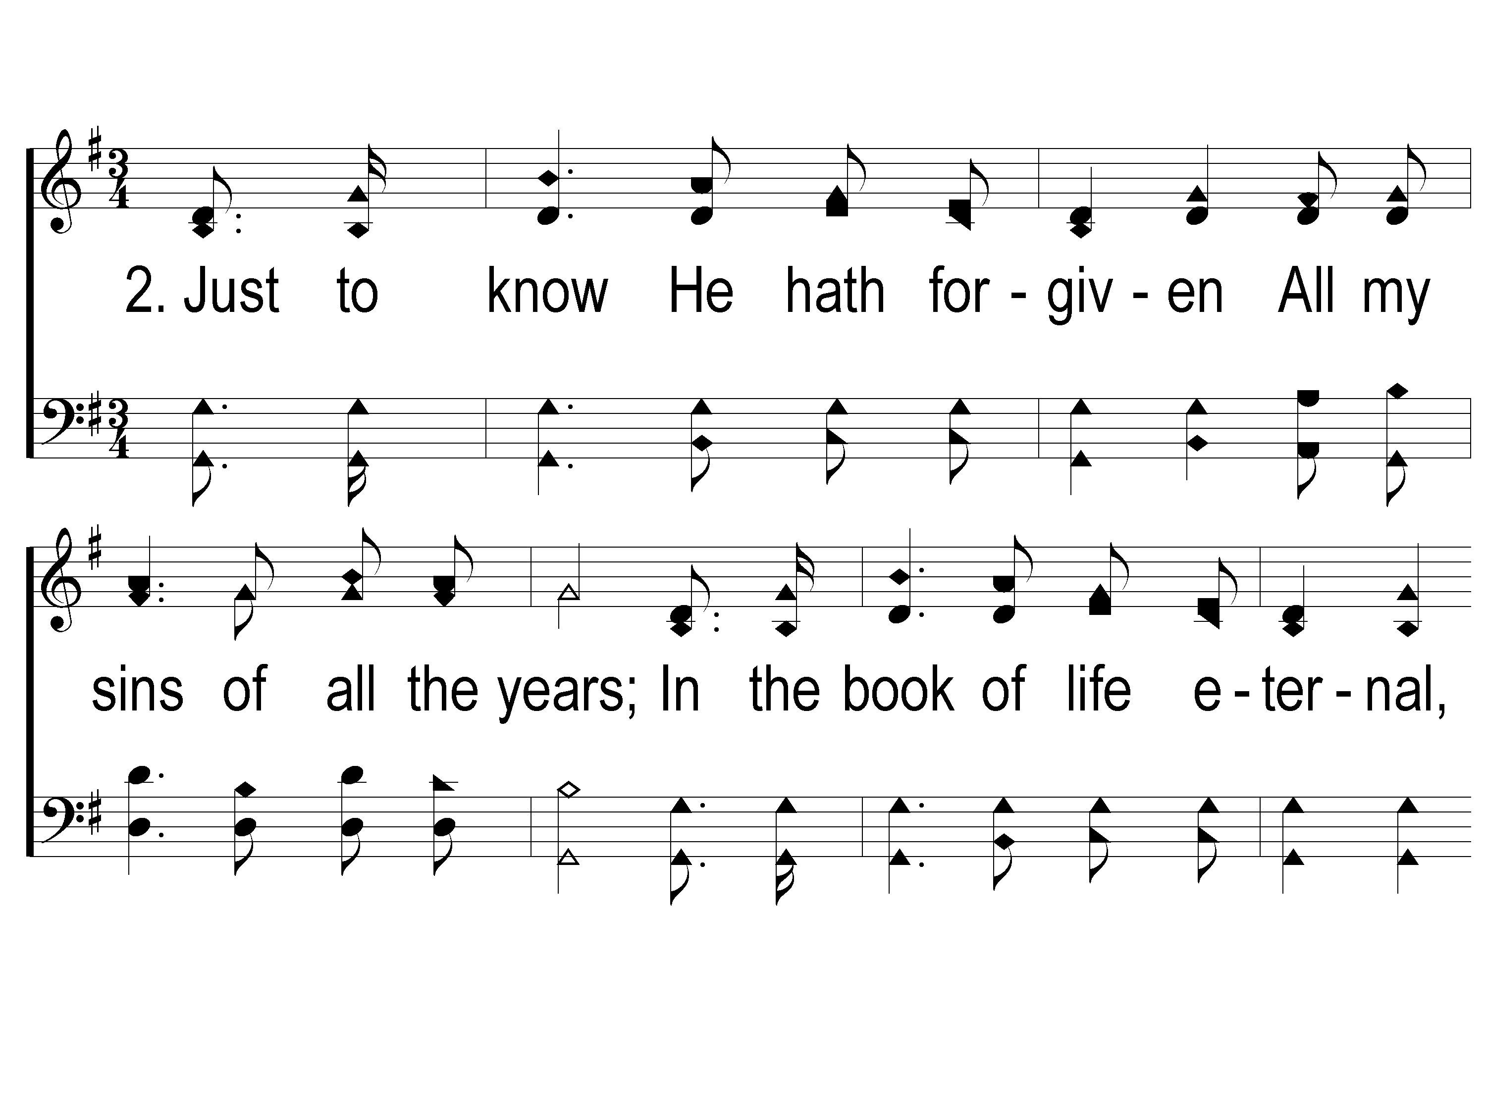
2-1 Just to Know
Just To Know
81
ePraise Hymn Presentation © 2005 Taylor Publications
ePraise Hymn Presentation © 2005 Taylor Publications

Slide 5
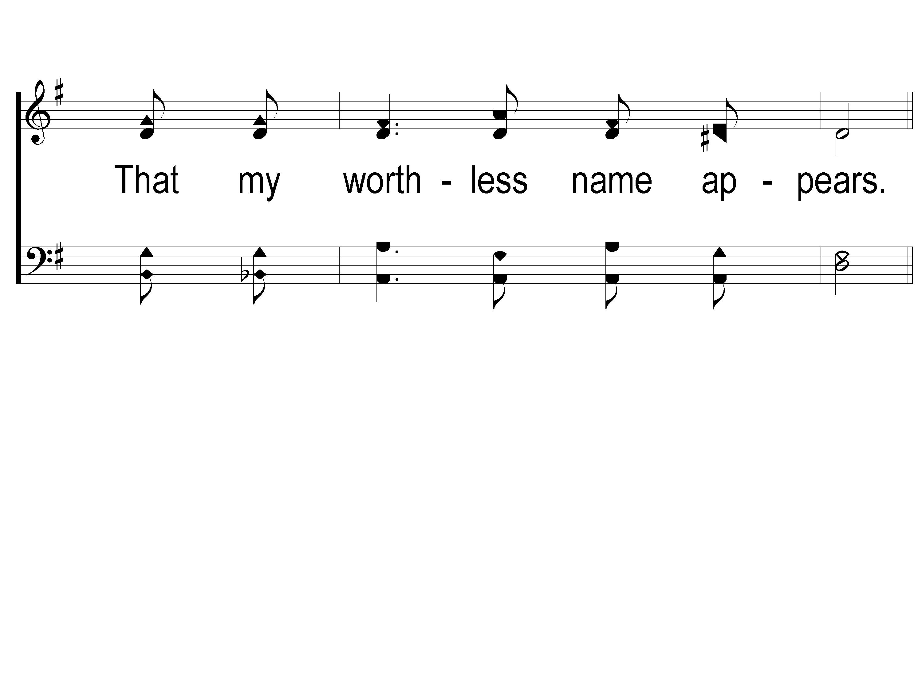
2-2 Just to Know
Just To Know
81
ePraise Hymn Presentation © 2005 Taylor Publications
ePraise Hymn Presentation © 2005 Taylor Publications

Slide 6
c Just to Know
Just To Know
81
ePraise Hymn Presentation © 2005 Taylor Publications
ePraise Hymn Presentation © 2005 Taylor Publications

Slide 7
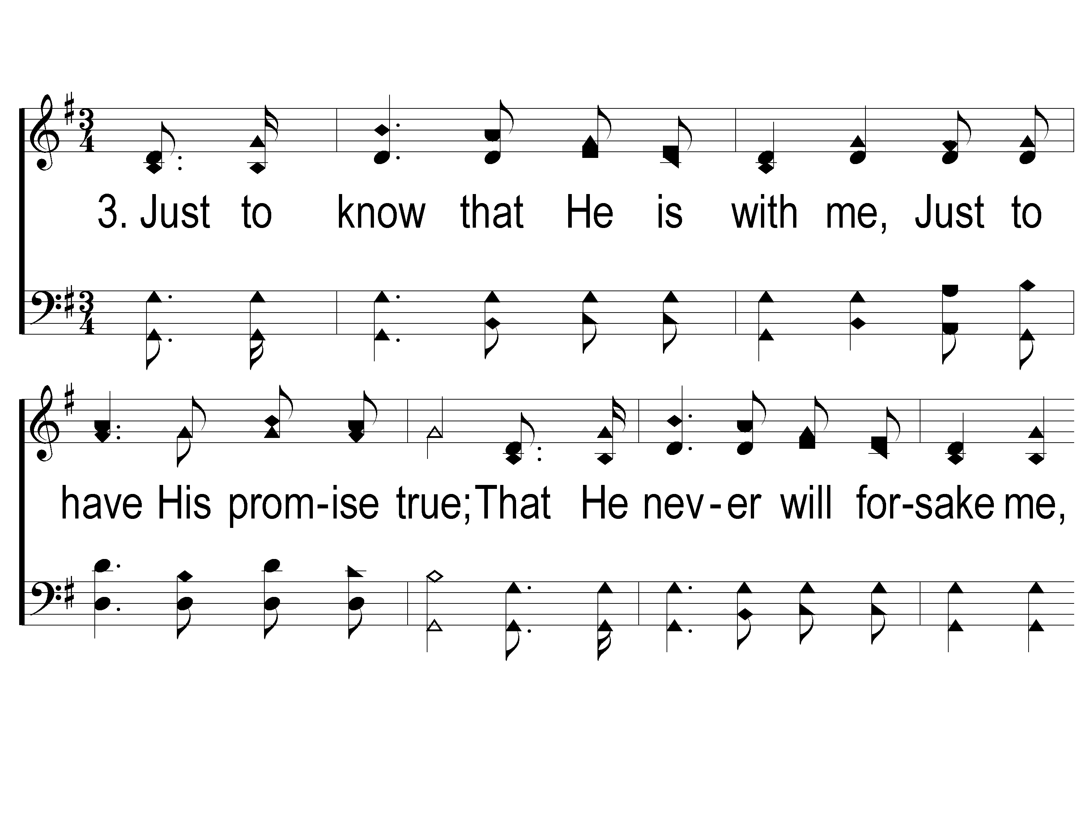
3-1 Just to Know
Just To Know
81
ePraise Hymn Presentation © 2005 Taylor Publications
ePraise Hymn Presentation © 2005 Taylor Publications

Slide 8
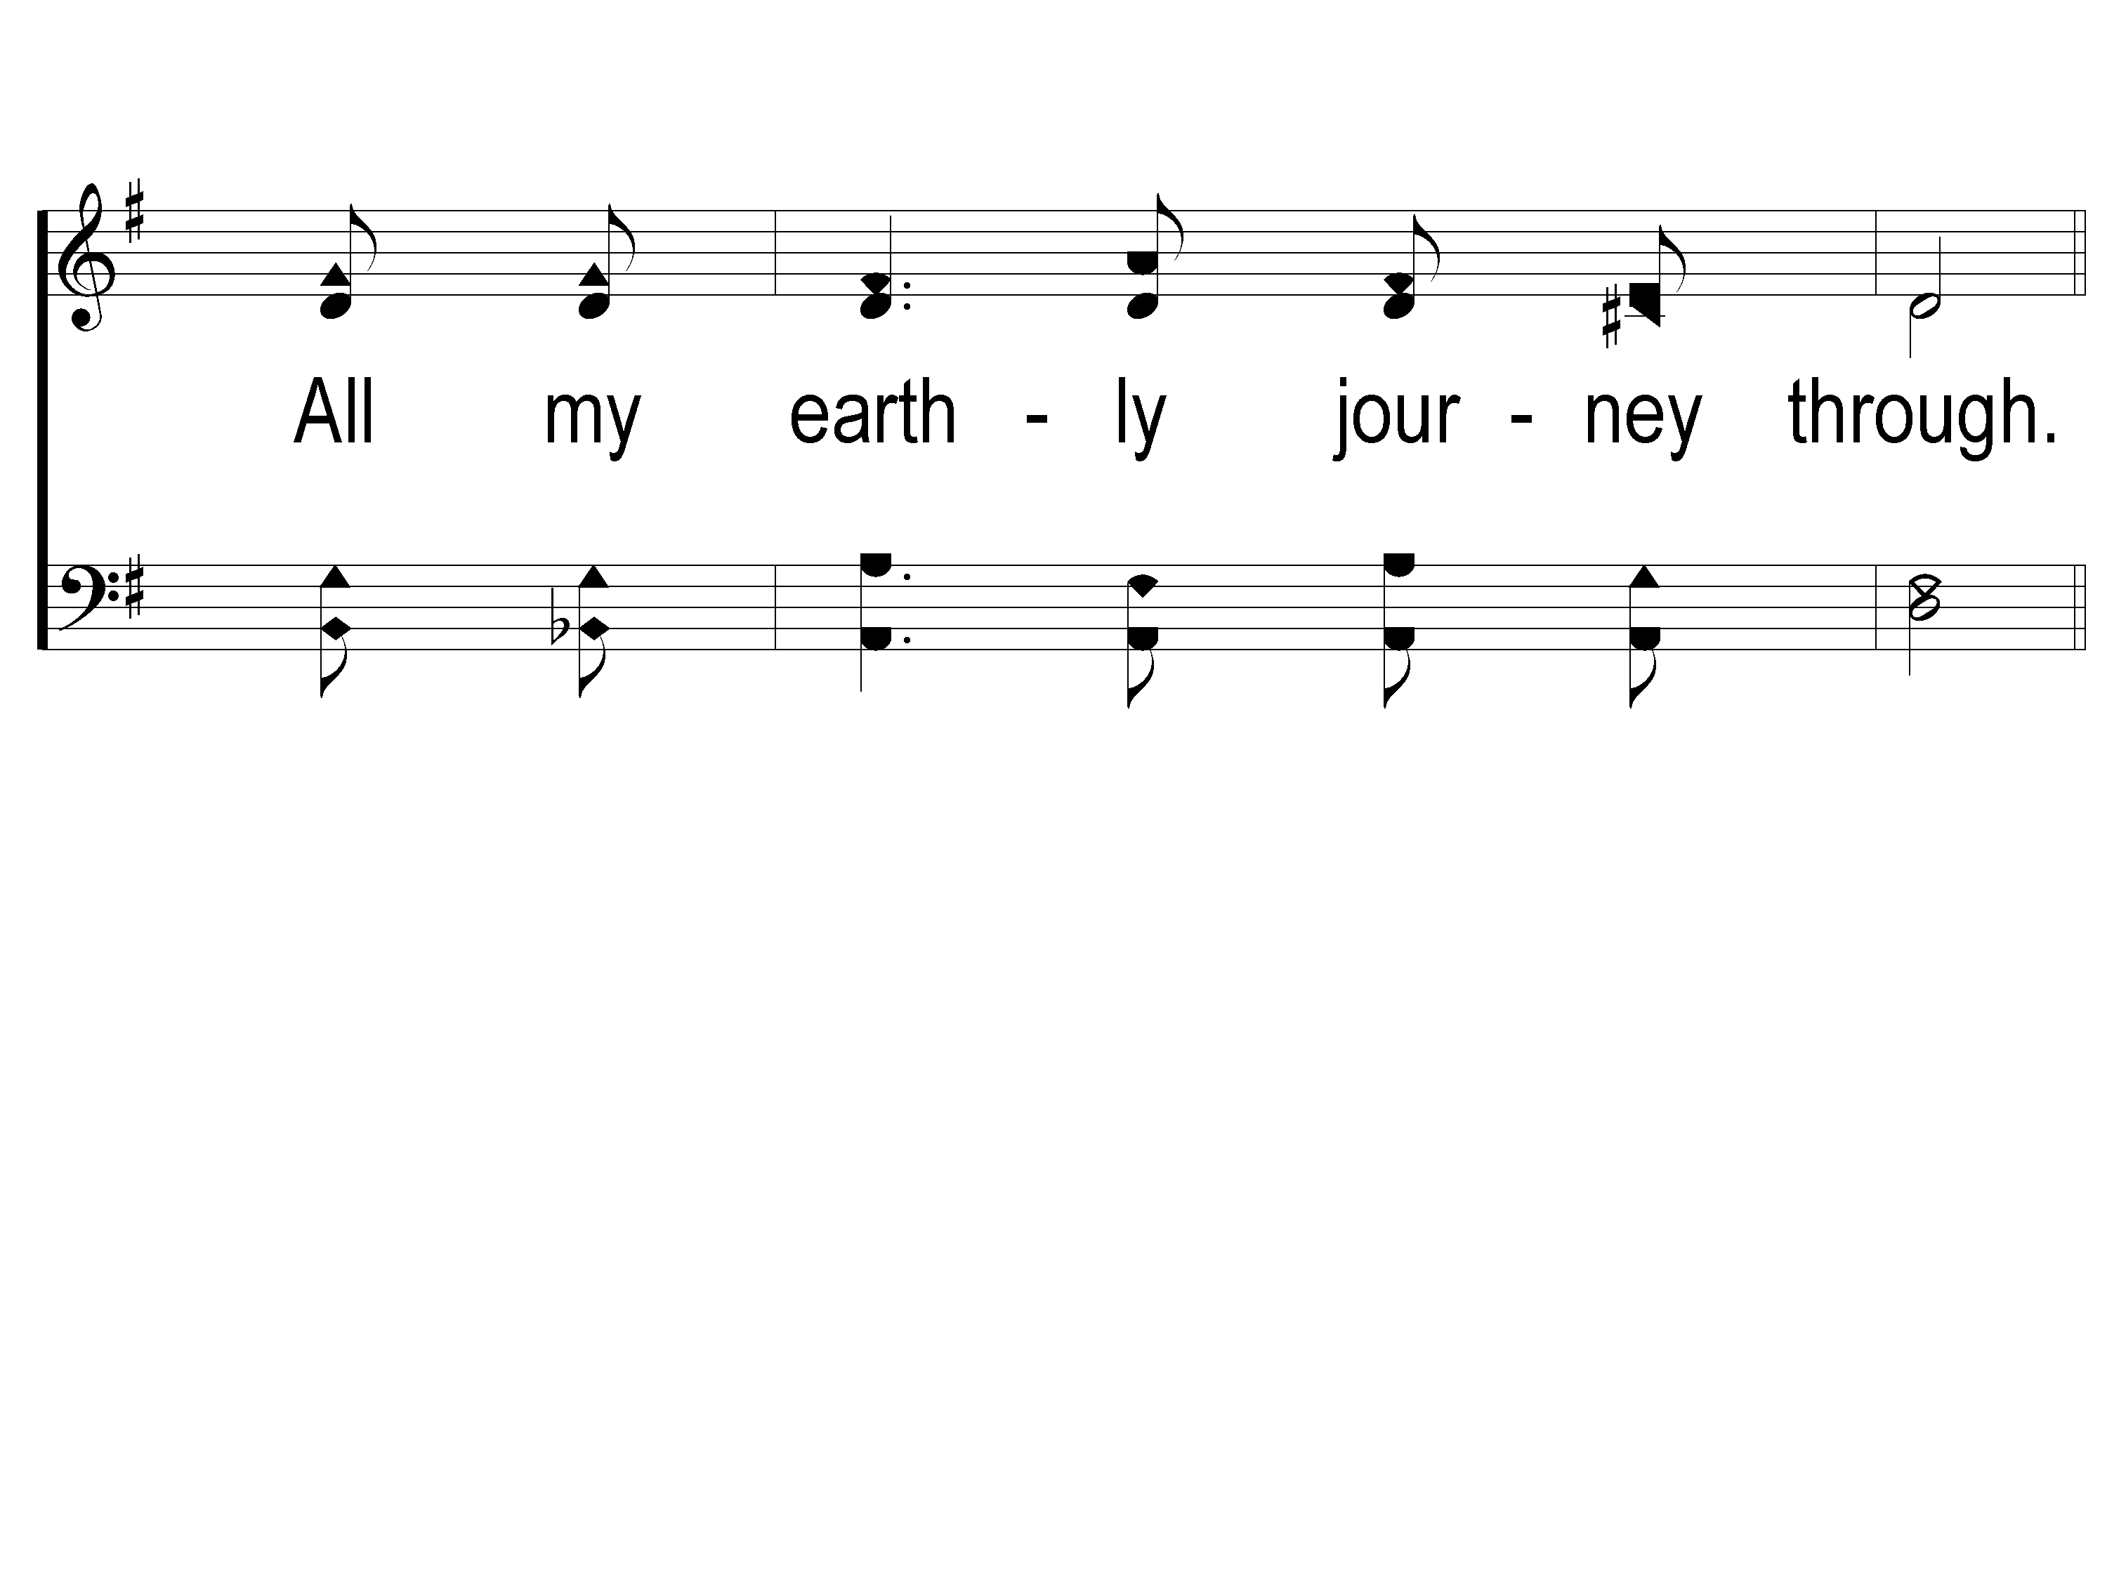
3-2 Just to Know
Just To Know
81
ePraise Hymn Presentation © 2005 Taylor Publications
ePraise Hymn Presentation © 2005 Taylor Publications

Slide 9
c Just to Know
Just To Know
81
ePraise Hymn Presentation © 2005 Taylor Publications
ePraise Hymn Presentation © 2005 Taylor Publications

Slide 10
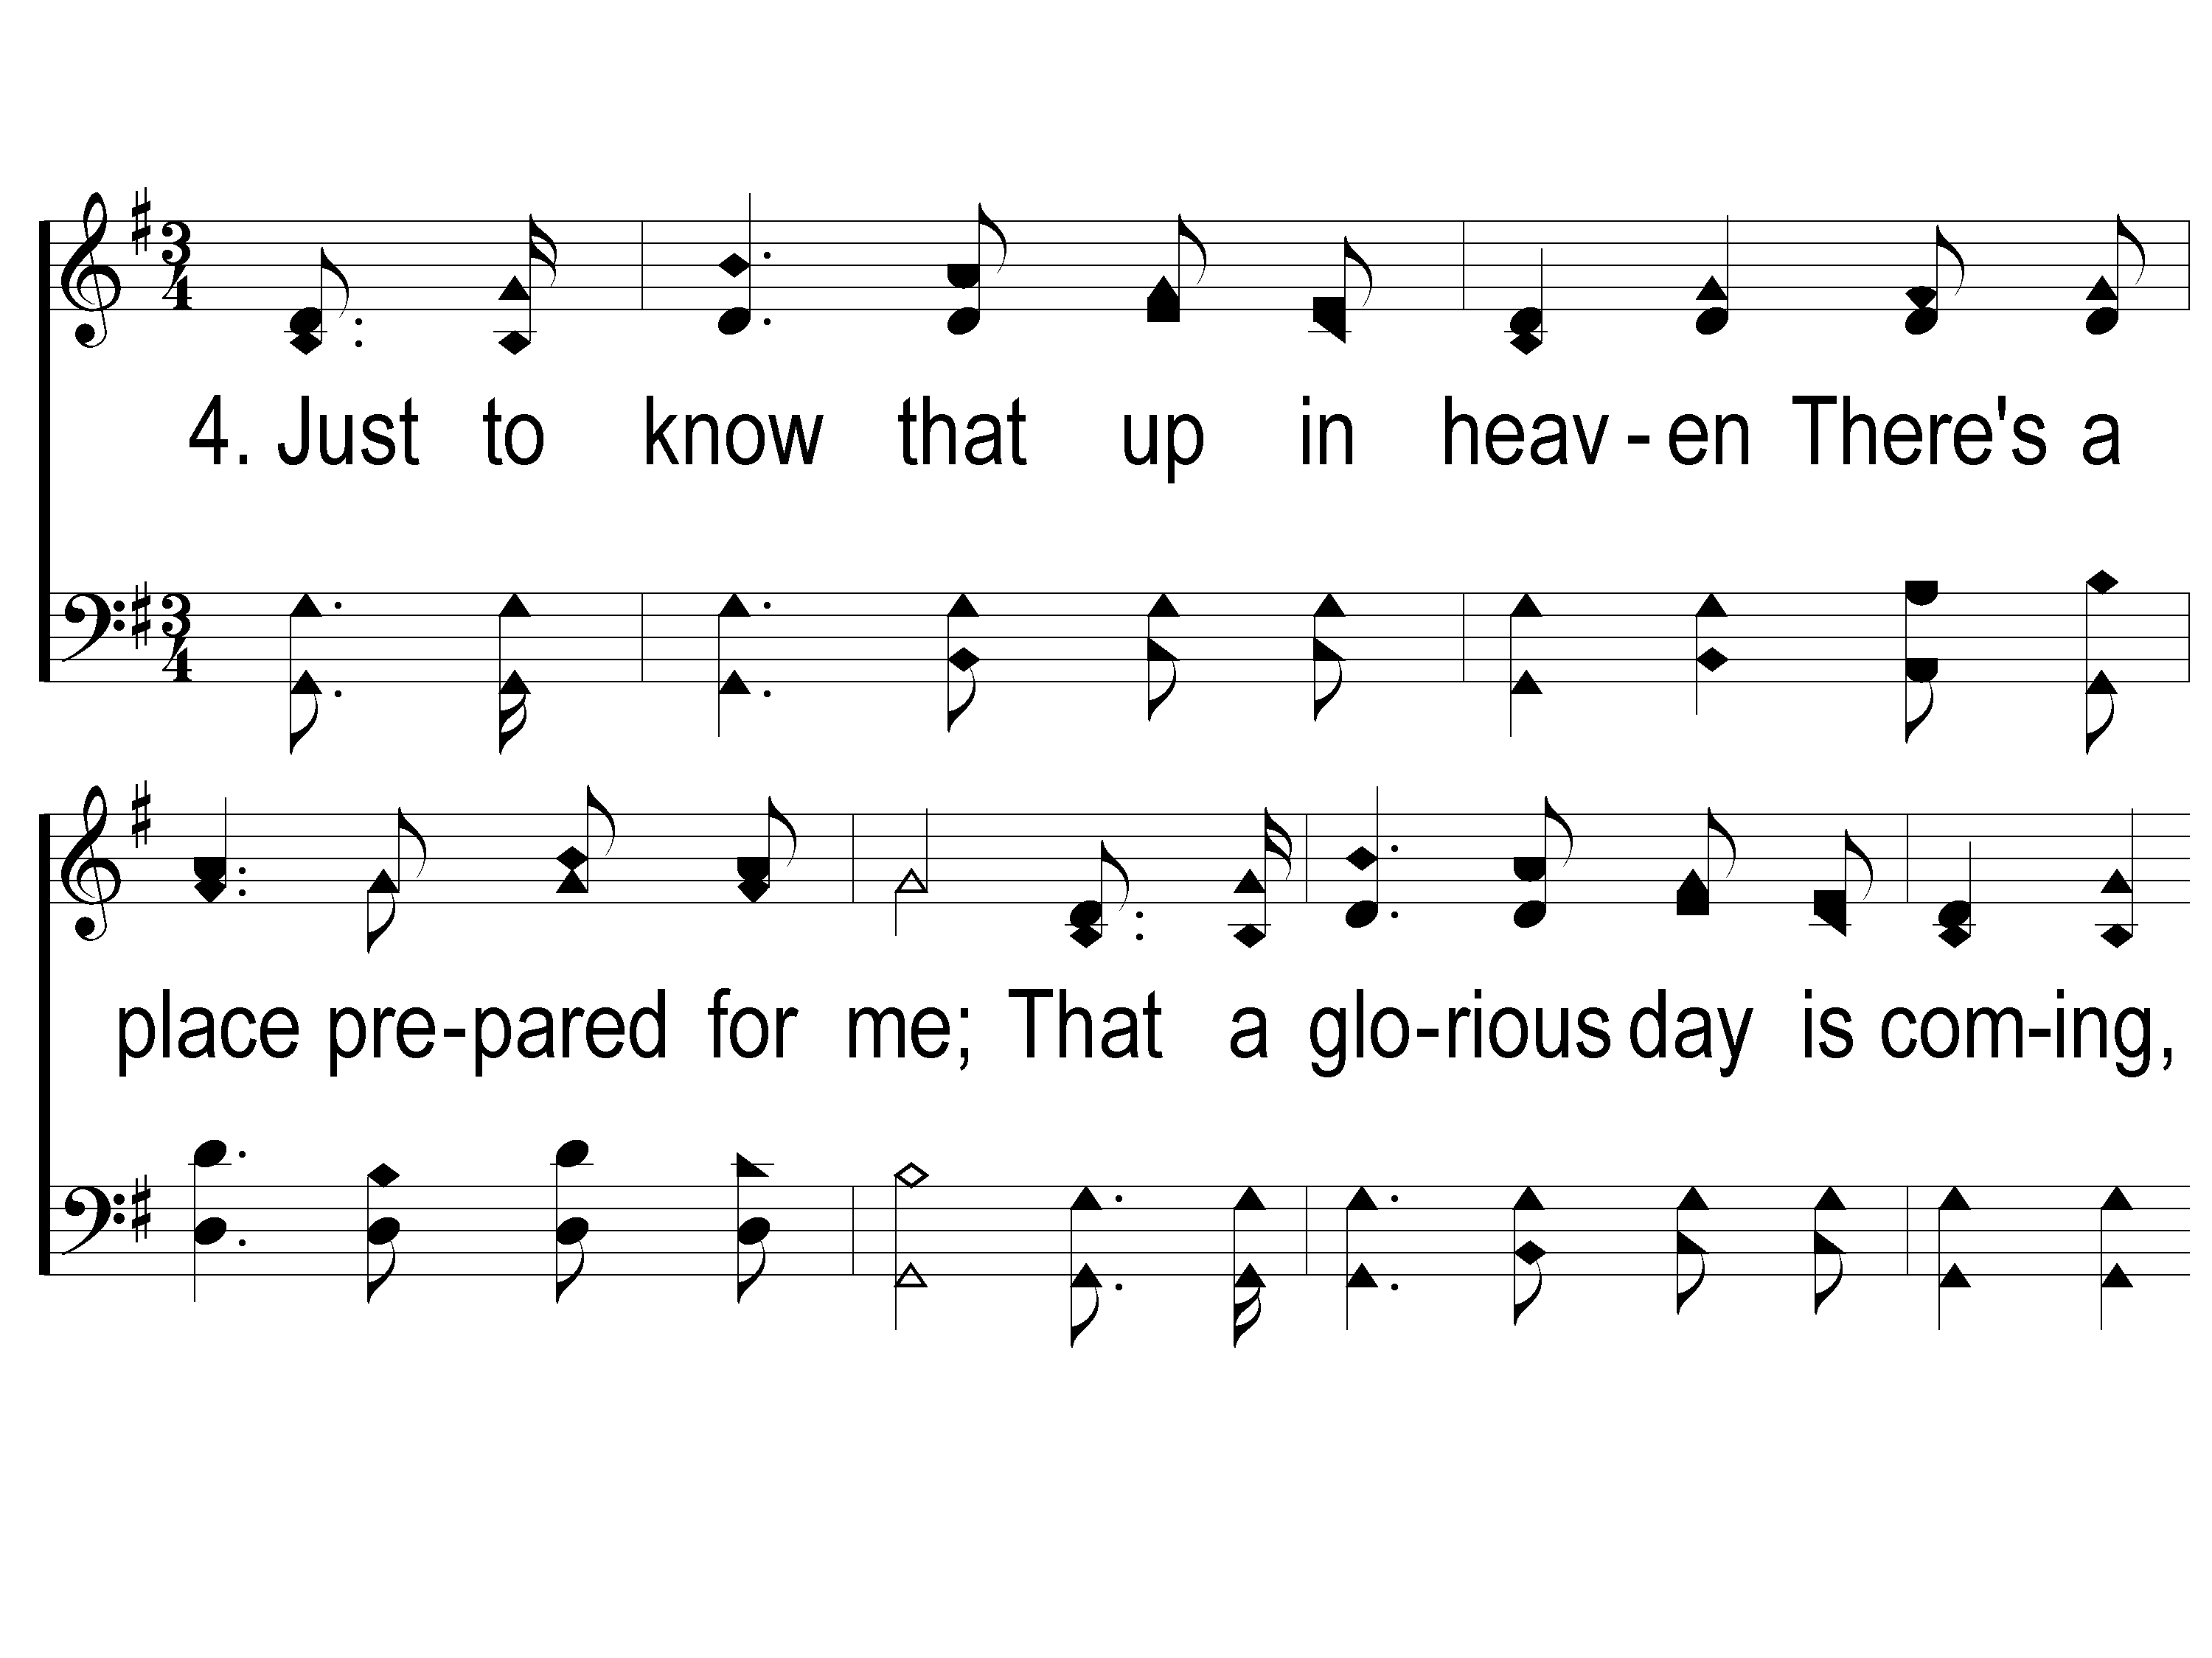
4-1 Just to Know
Just To Know
81
ePraise Hymn Presentation © 2005 Taylor Publications
ePraise Hymn Presentation © 2005 Taylor Publications

Slide 11
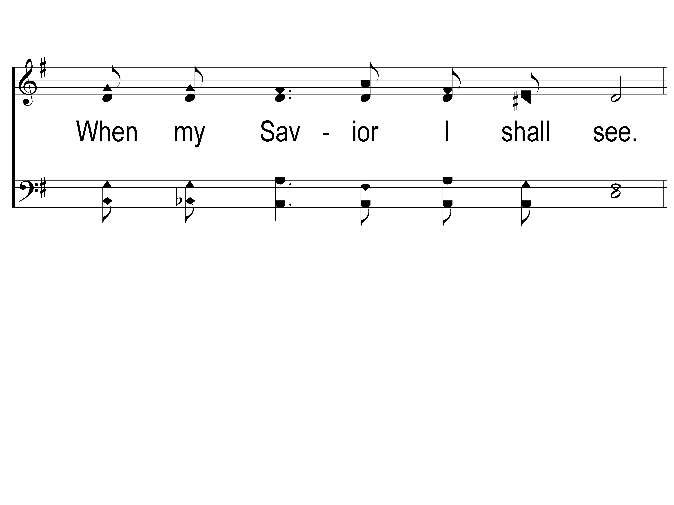
4-2 Just to Know
Just To Know
81
ePraise Hymn Presentation © 2005 Taylor Publications
ePraise Hymn Presentation © 2005 Taylor Publications

Slide 12
c Just to Know
Just To Know
81
ePraise Hymn Presentation © 2005 Taylor Publications
ePraise Hymn Presentation © 2005 Taylor Publications

